Slide 1
SMA & HULL TACTICAL Week 8

Slide 2
Today’s Outline
Preprocessing data and train-test split
Model : Linear Regression
Model : Random Forest Regression
Model : Polynomial Regression
Model : Deep Learning Regression
Conclusion
Notes:
Main point of this week: feature filtering

Slide 3
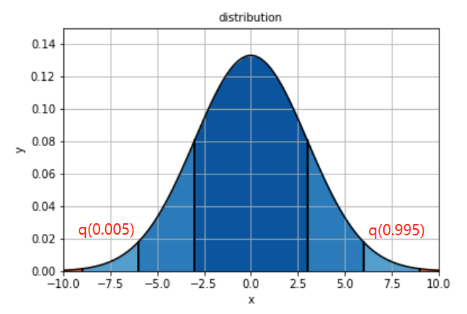
Processing Data
Train Set: data until 05/2017
Test Set: data from 06/2017 to 12/2017
Use Train Set to find Q(0.005) and Q(0.995)
Then do winsorizing on Test Set.
Check if stationary.
Standardize data.

Slide 4
Linear Regression
R-score | MSE
﻿-0.0146024286 | ﻿0.0000165028
Train Size | Test Size
﻿464 | ﻿126
Confusion matrix | True up | True down | Total
Prediction up | 69 | 43 | 112
Prediction down | 9 | 5 | 14
Total | 78 | 48 | 126
Alpha | L1_Ratio
0.00566 | ﻿0.1111
Prediction is biased.
Long-side precision: 61.6%
Long-side recall: 88%

Slide 5
Random Forest Regression
R-score | MSE
﻿-0.0081229468 | ﻿﻿﻿0.000016397
Train Size | Test Size
﻿464 | ﻿126
Confusion matrix | True up | True down | Total
Prediction up | 78 | 46 | 124
Prediction down | 0 | 2 | 2
Total | 78 | 48 | 126
Best leaf nodes | Estimators
2 | ﻿71
Prediction is highly biased.

Slide 6
Random Forest Regression

Slide 7
Polynomial Regression
R-score | MSE
﻿-24.6084374569 | ﻿﻿﻿0.00041653077
Train Size | Test Size
﻿464 | ﻿126
Confusion matrix | True up | True down | Total
Prediction up | 44 | 33 | 77
Prediction down | 34 | 15 | 49
Total | 78 | 48 | 126
Degree
2
Long-side precision: 57.1%
Long-side recall: 56.4%

Slide 8
Deep Learning Regression
R-score | MSE
﻿-132.70355068 | ﻿﻿﻿0.0021747380
Train Size | Test Size
﻿464 | ﻿126
Confusion matrix | True up | True down | Total
Prediction up | 35 | 10 | 45
Prediction down | 43 | 38 | 81
Total | 78 | 48 | 126
layer1 | layer2 | layer3
20 | ﻿20 | 60
Highly diversified.
Long-side precision: 77.8%
Long-side recall: 44.9%

Slide 9
Conclusion
 | R square | MSE | Precision | Recall
Linear Regression | ﻿-0.0146024286 | 0.000016503 | 61.6% | 88%
Random Forest | ﻿-0.0081229468 | 0.000016397 | 62.9% | 100%
Polynomial Regression | ﻿-24.608437457 | ﻿﻿﻿﻿0.000416530 | 57.1% | 56.4%
Deep Neutral Network | ﻿-132.70355068 | 0.002174738 | 77.8% | 44.9%

Slide 10
Thank you!
Notes:
PCA is orthorgonal transformation of each factor

